Slide 1
Battery
Vehicle computer
Power distribution unit
Network switch
Actuator controller
Sensor DAC unit
Actuator
Pressure sensor
Pressure sensor
Pressure sensor

Slide 2
Workflow Overview
User editable per product
Generated file
When you “render” a product (run harnice –r from the command line or GUI button press), a long process is executed.
During the process, existing information is queried, processed, and every output is regenerated.
device
Device Feature Tree
Device Signals List
Device Kicad Symbol
System Definition (kicad_sch)
System Feature Tree
System Instances List
system
Harness feature tree
Harness Instances List
Harness Build Drawing PDF set
harness

Slide 3
Defined Manually
Defined in Device Feature Tree
Defined in System Feature Tree
Defined in Harness Feature Tree
Device Signals List
Device, channel definitions
System build rules
KiCad symbol
Channel map, disconnect map, circuits list
System Instances List
System harness manifest, post harness instances list
System simulation processor
KiCad block diagram
Netlist
Harness build rules
Harness instances list
Harness drawings

Slide 4
Signals List Feature Tree
You can use a script to easily write long Signals Lists. Rely on basic Python to avoid typing manually.
harnice -r device
Or
harnice -r disconnect
Signals List Exists
no
yes
Feature Tree Exists
Feature Tree Exists
yes
yes
no
no
Make new feature_tree.py from default
Run feature_tree.py
Validate and exit

Slide 5
PDF Generator
This is the notional flow of SVG content when you run the PDF generator macro.
Titleblocks in library repo
The graph on this page shows the relevant part of the file hierarchy of a harness project.
Harness rev folder
directory
instance_data
json
svg
Literally any file that ends in –master.svg
imported_instances
PDF
1. Import titleblock content into project
Titleblock
Macro
Project titleblock folders
{Macro that called it}-
{page number}-
{page name}
4. Go find all generated content
{Macro ID}
Library_used_do_not_edit
Page_svgs
Page_setup.json
Project titleblock files
direct_from_project_titleblock
Master contents svg
{macro id}-{page name}-attributes.json
5. Merge into user editable page svg
Output PDF
6. Combine into output PDF
{macro id}-{page name}-drawing.svg
{page_counter}-{page name}-user editable.svg
1.5 User can edit titleblocks directly here
2. Copy into macro directory
Macro-{macro ID}-{page name}
Macro titleblock files
5.5 User can configure page content and layout here by cloning master contents groups and placing the clones on the page
{macro id}-{page name}-attributes.json
5. Merge into user editable page svg
3. Text replacements automatically performed (adds page number, pn/rev, etc)
{macro id}-{page name}-drawing.svg
{macro id}-{page name}-drawing_with_text_replacements.svg

Slide 6
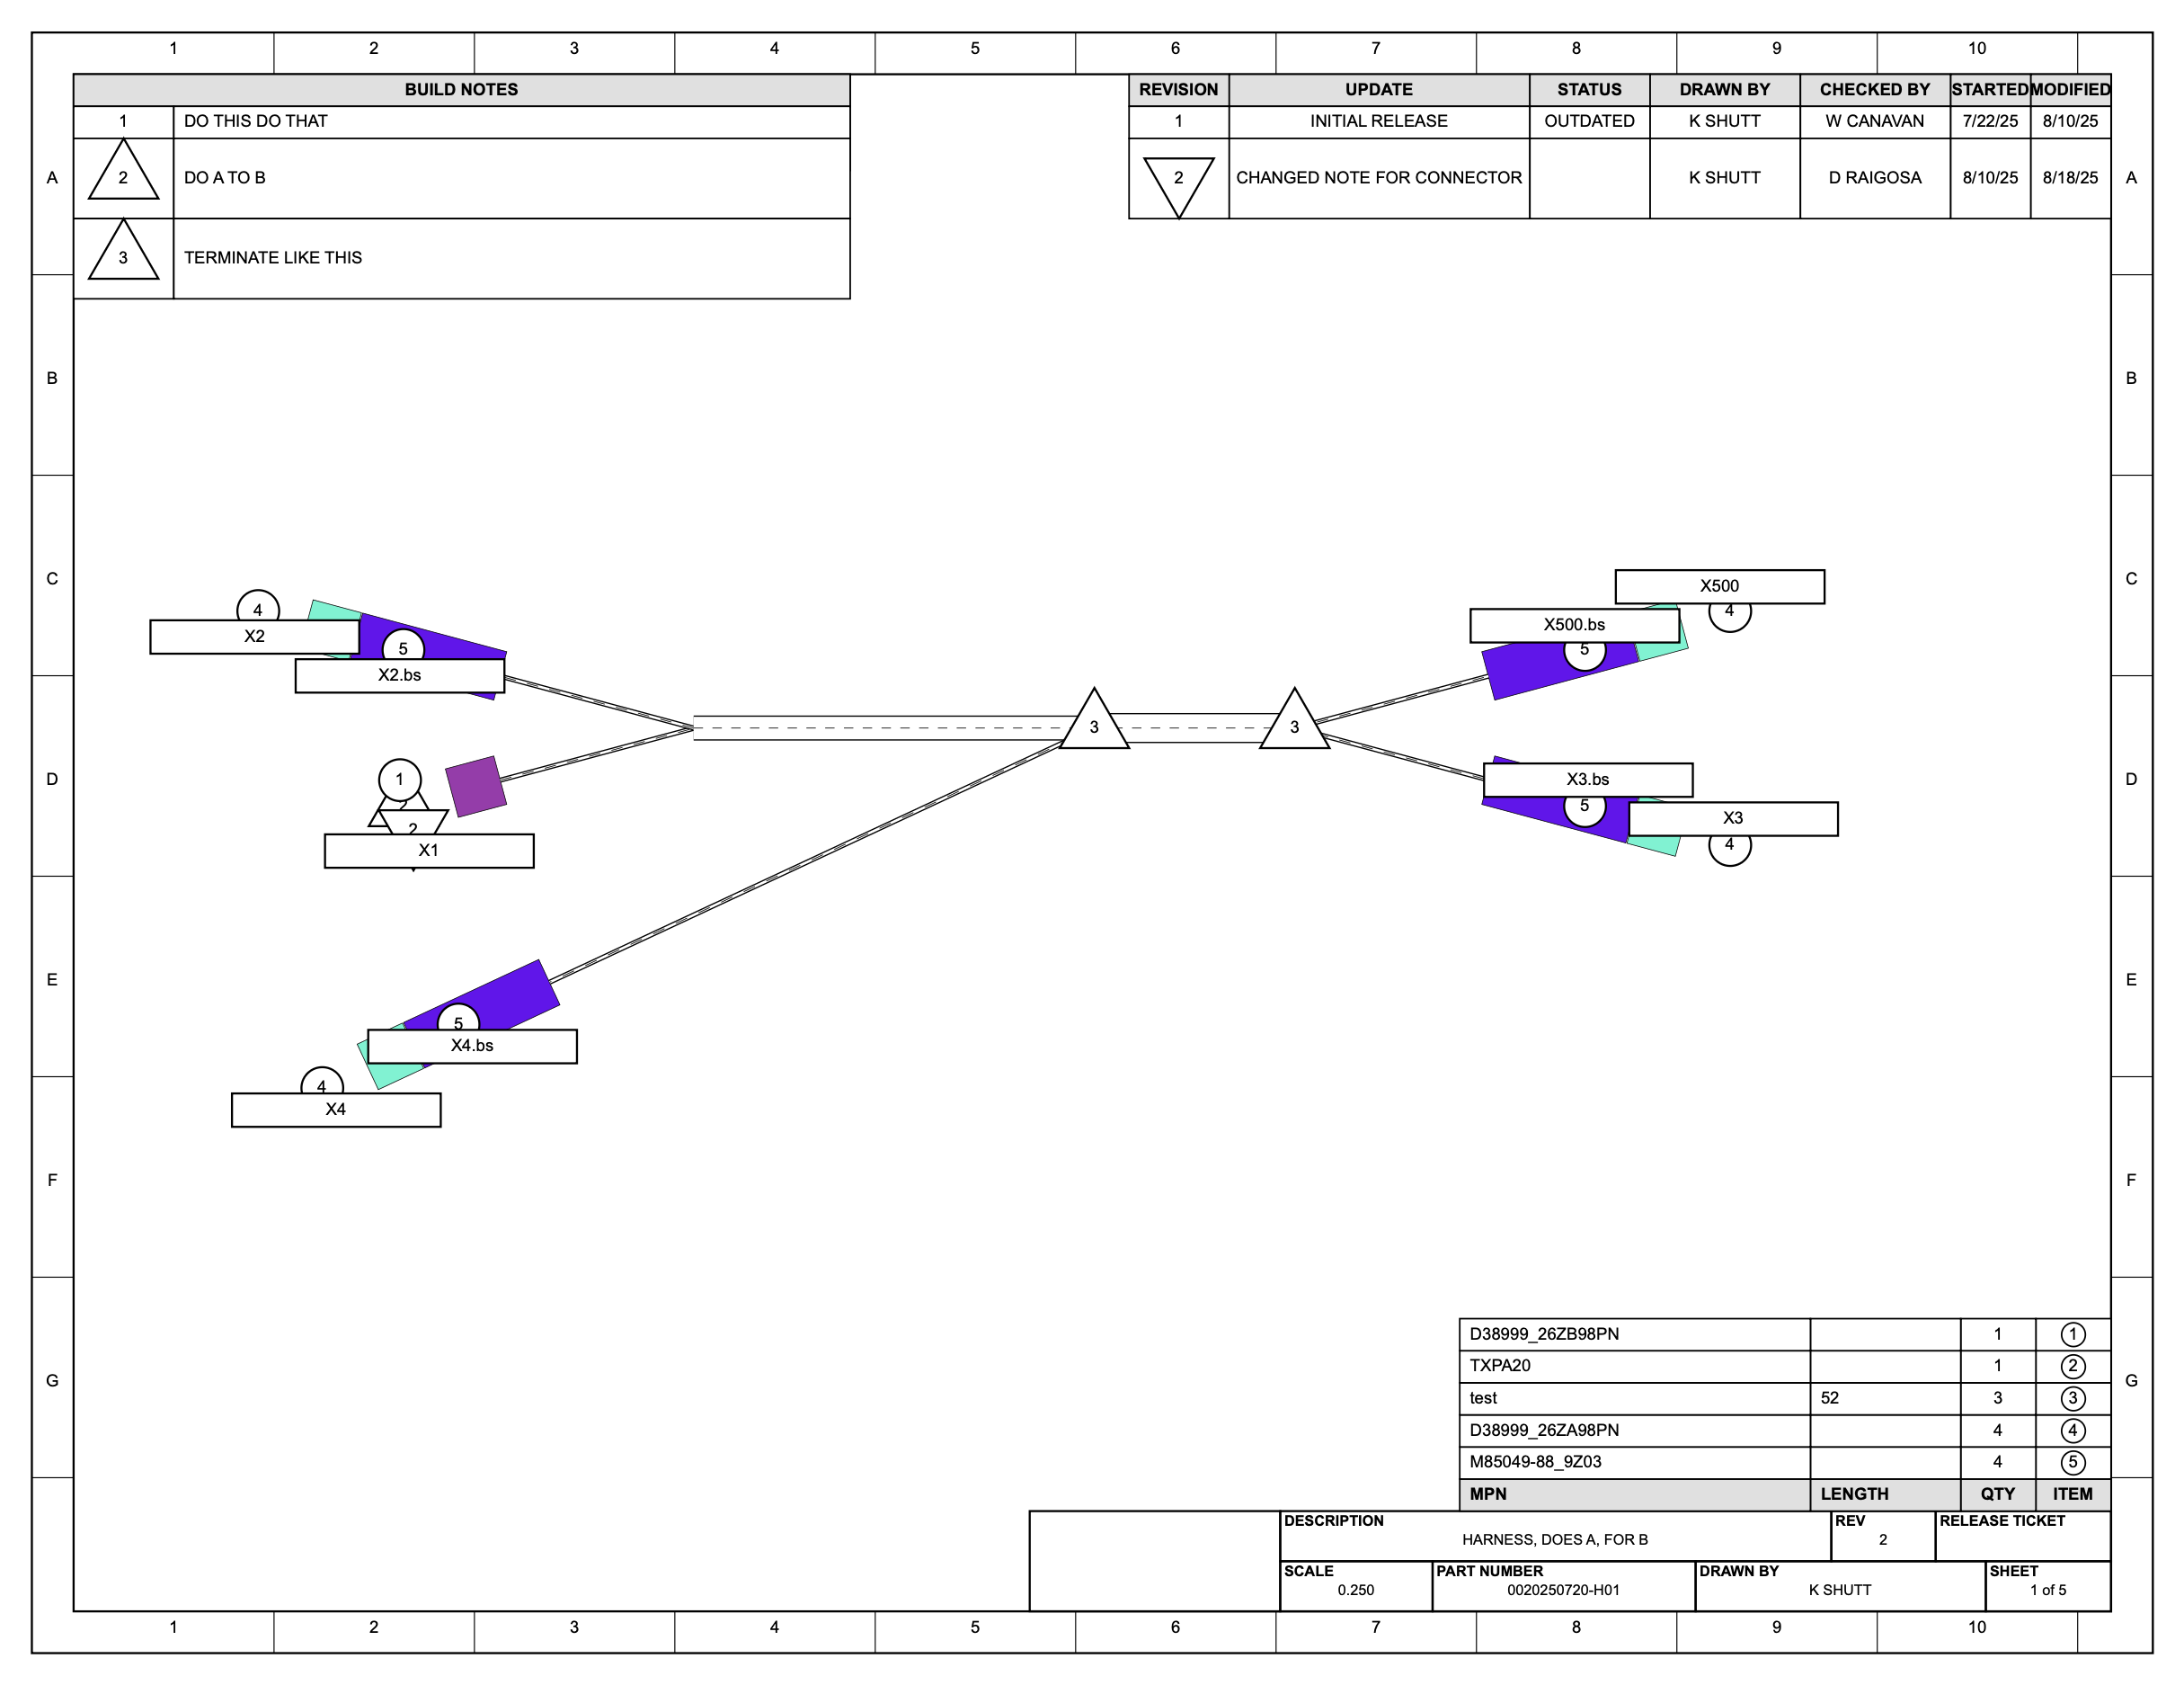

Slide 7
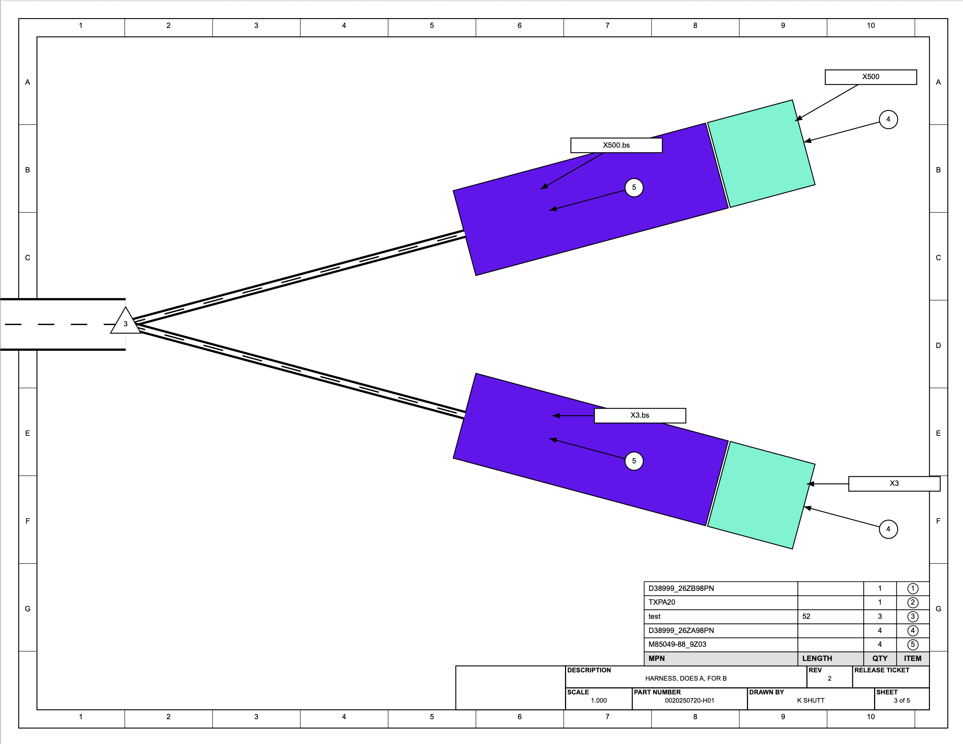

Slide 8
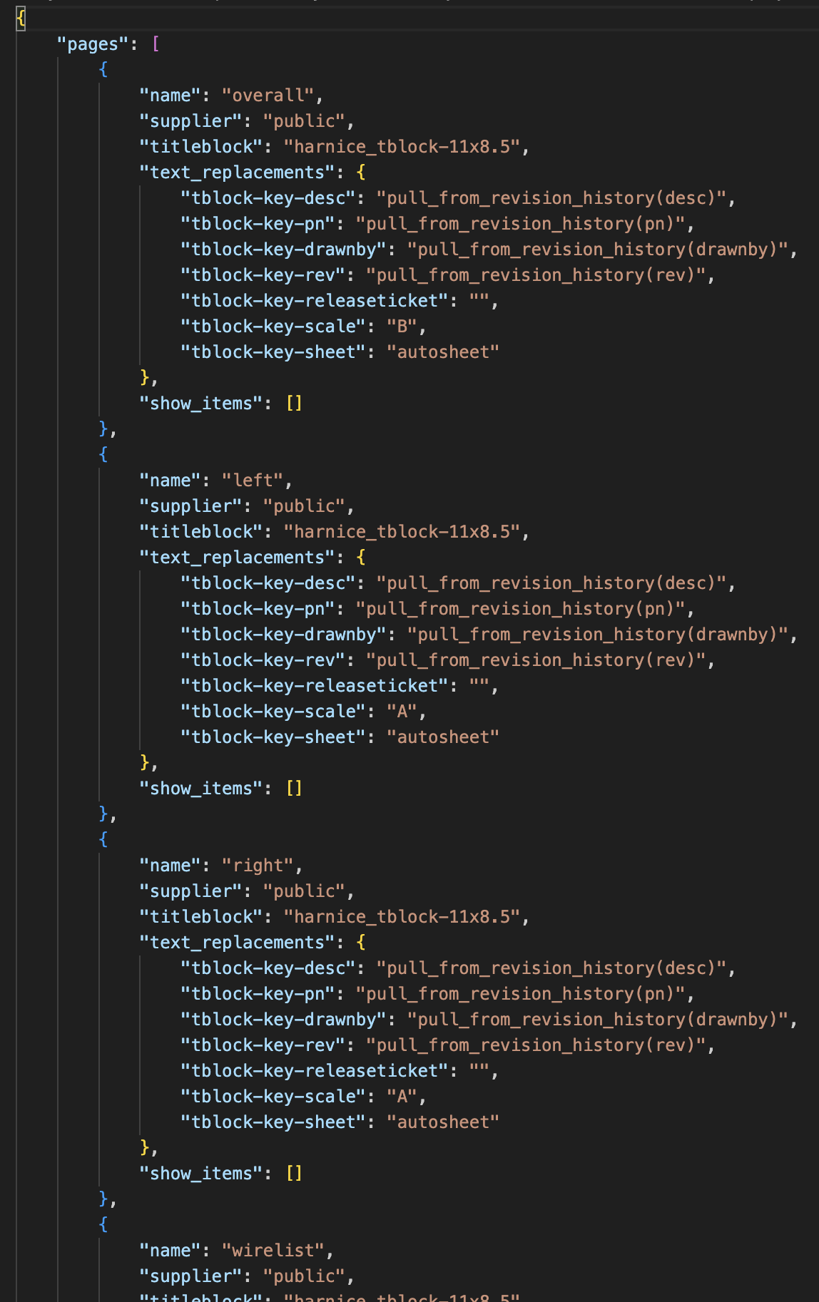
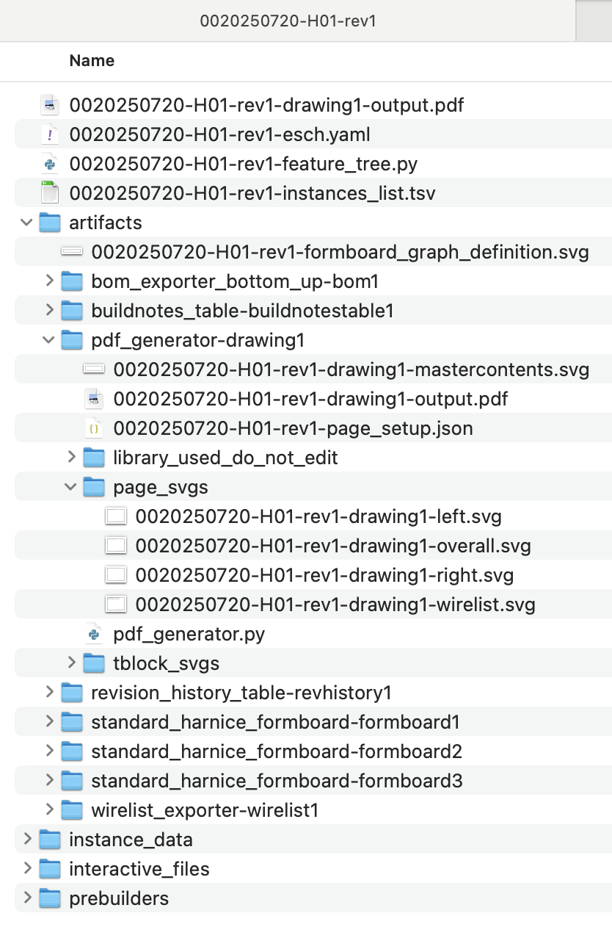
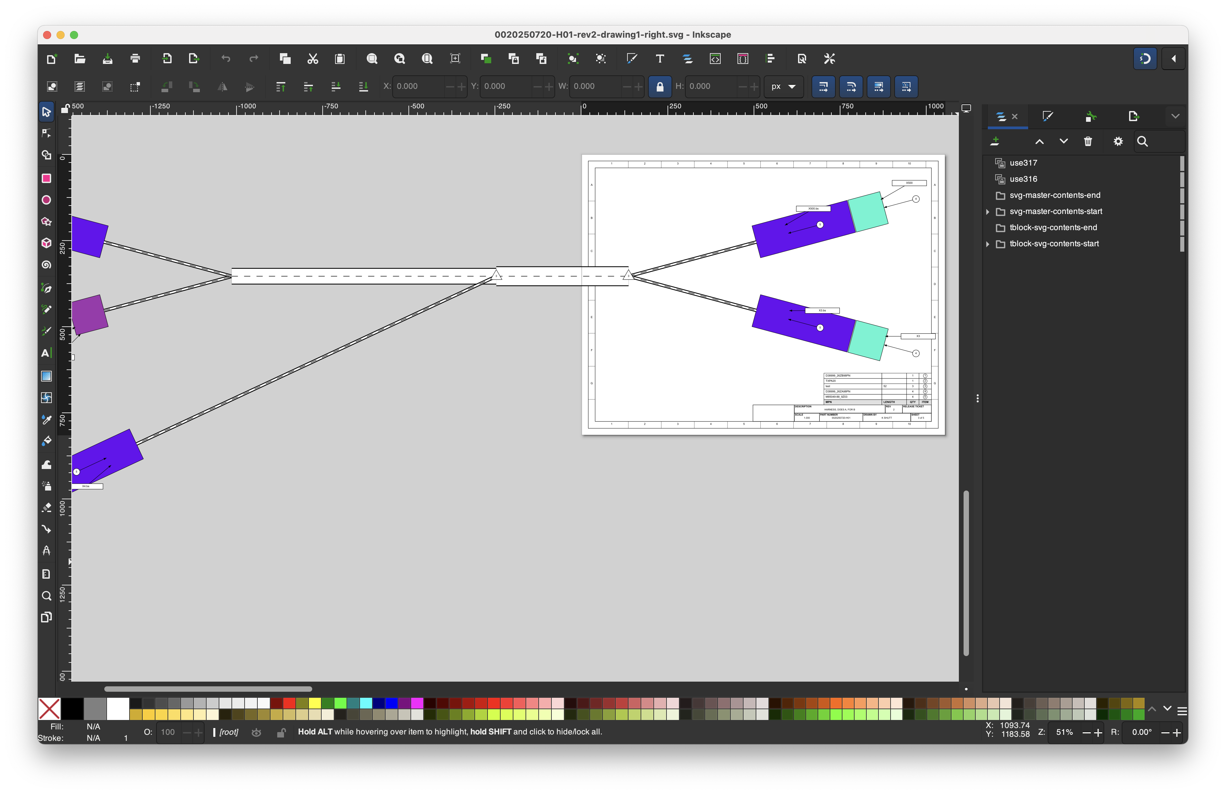

Slide 9
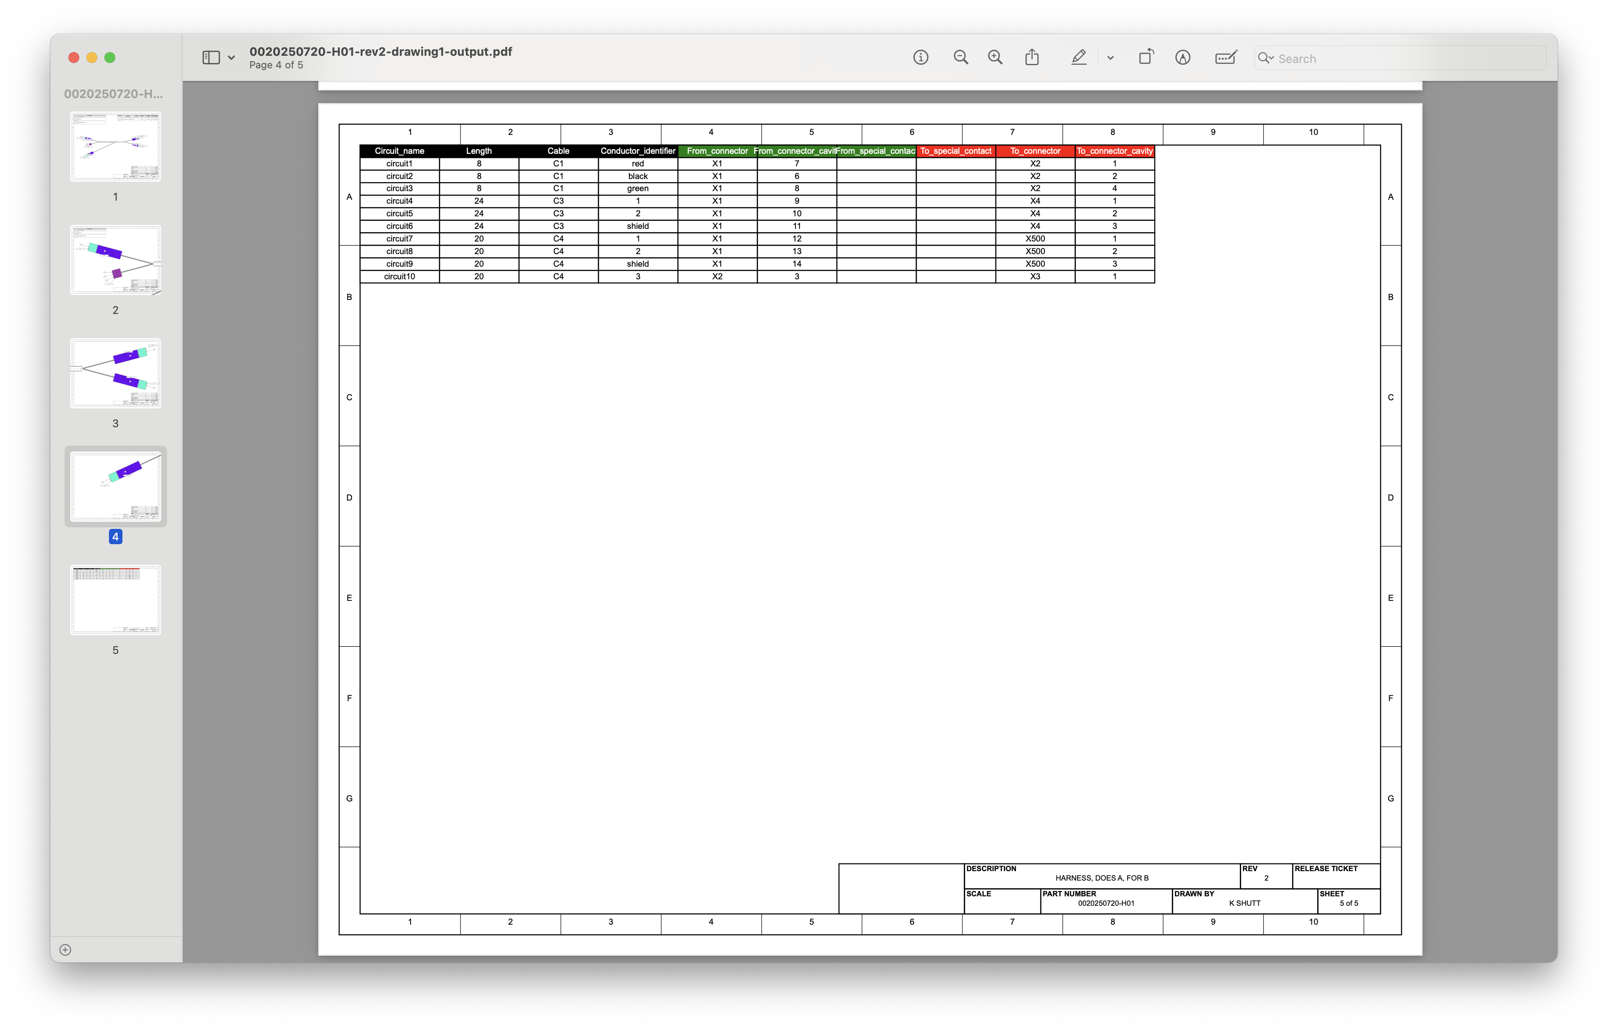
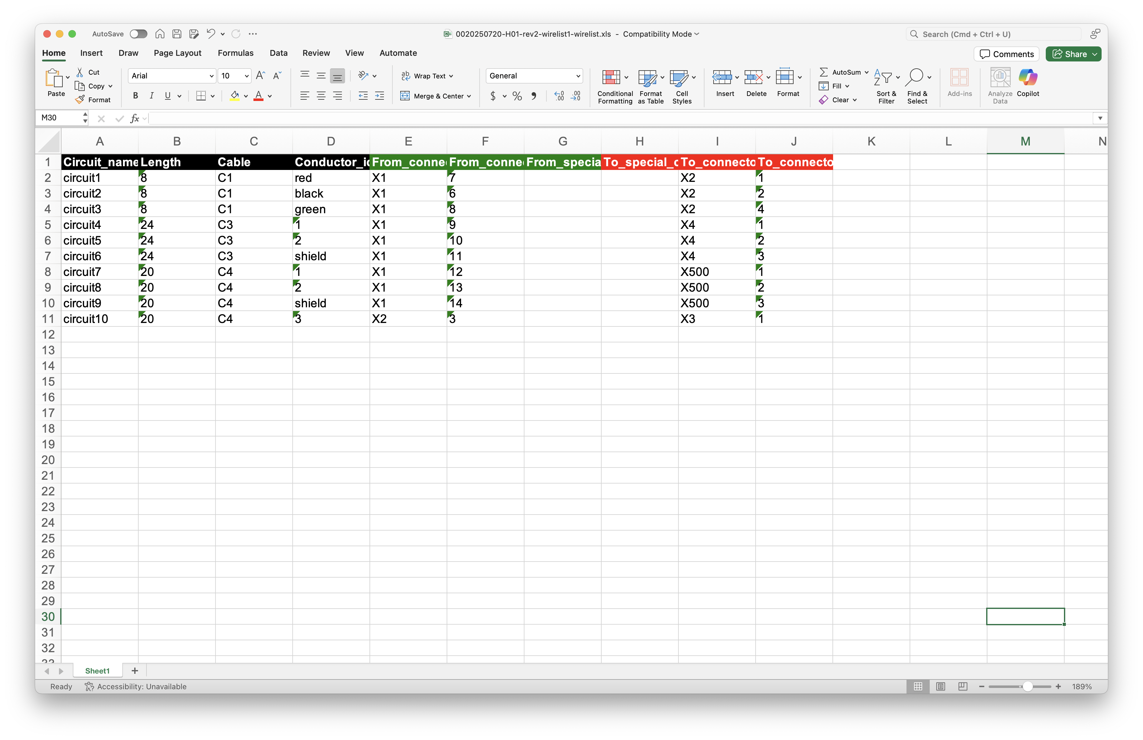
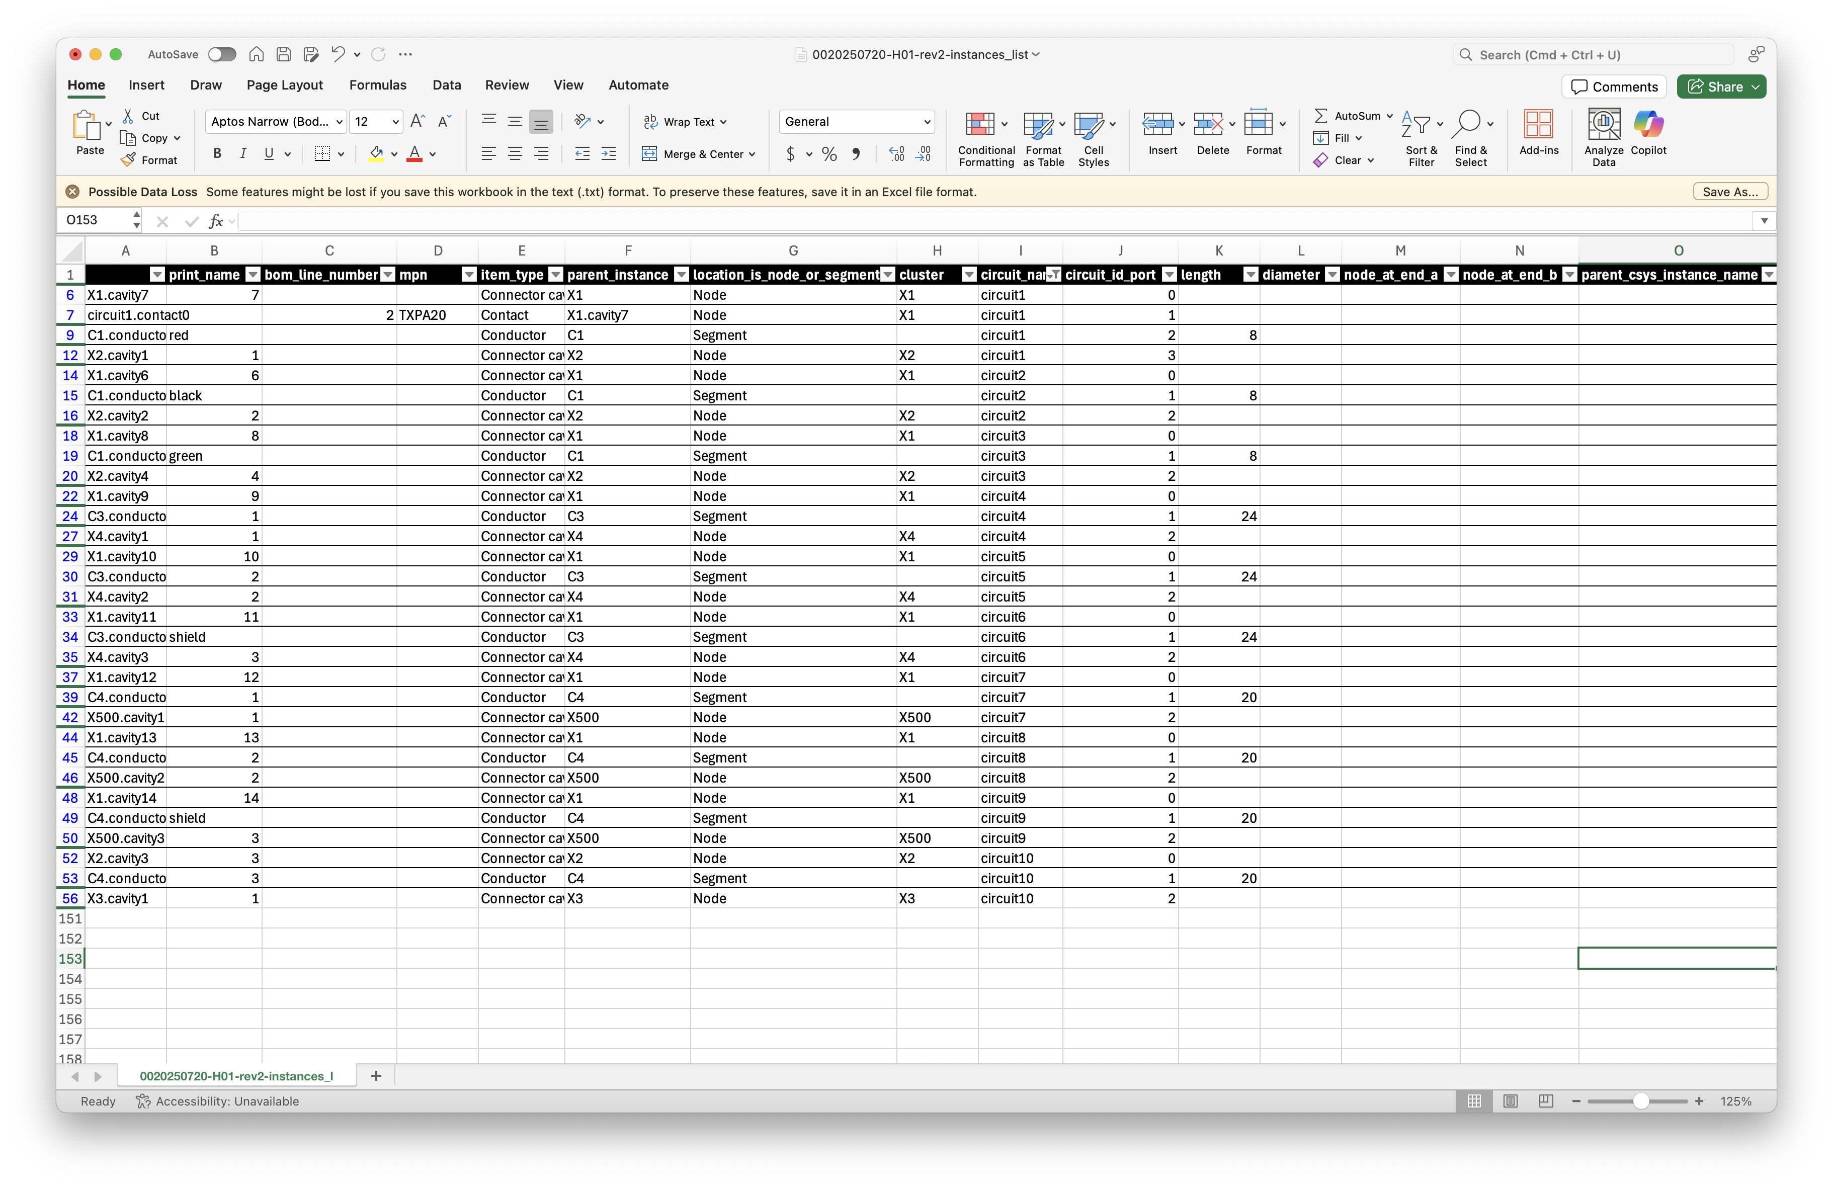

Slide 10
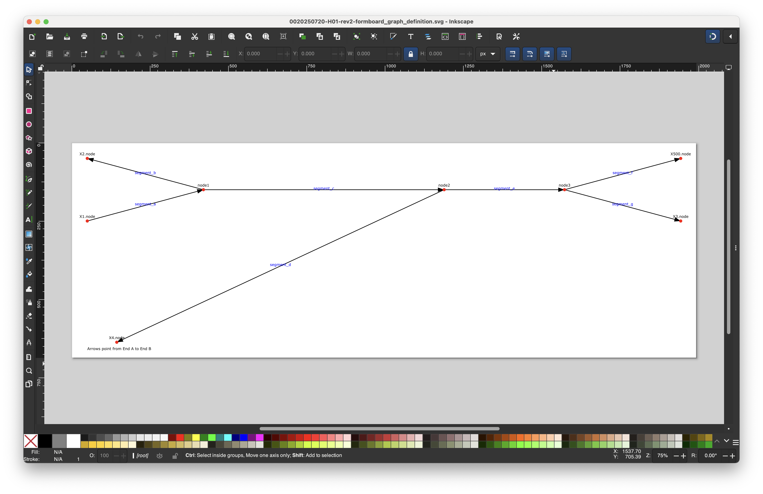
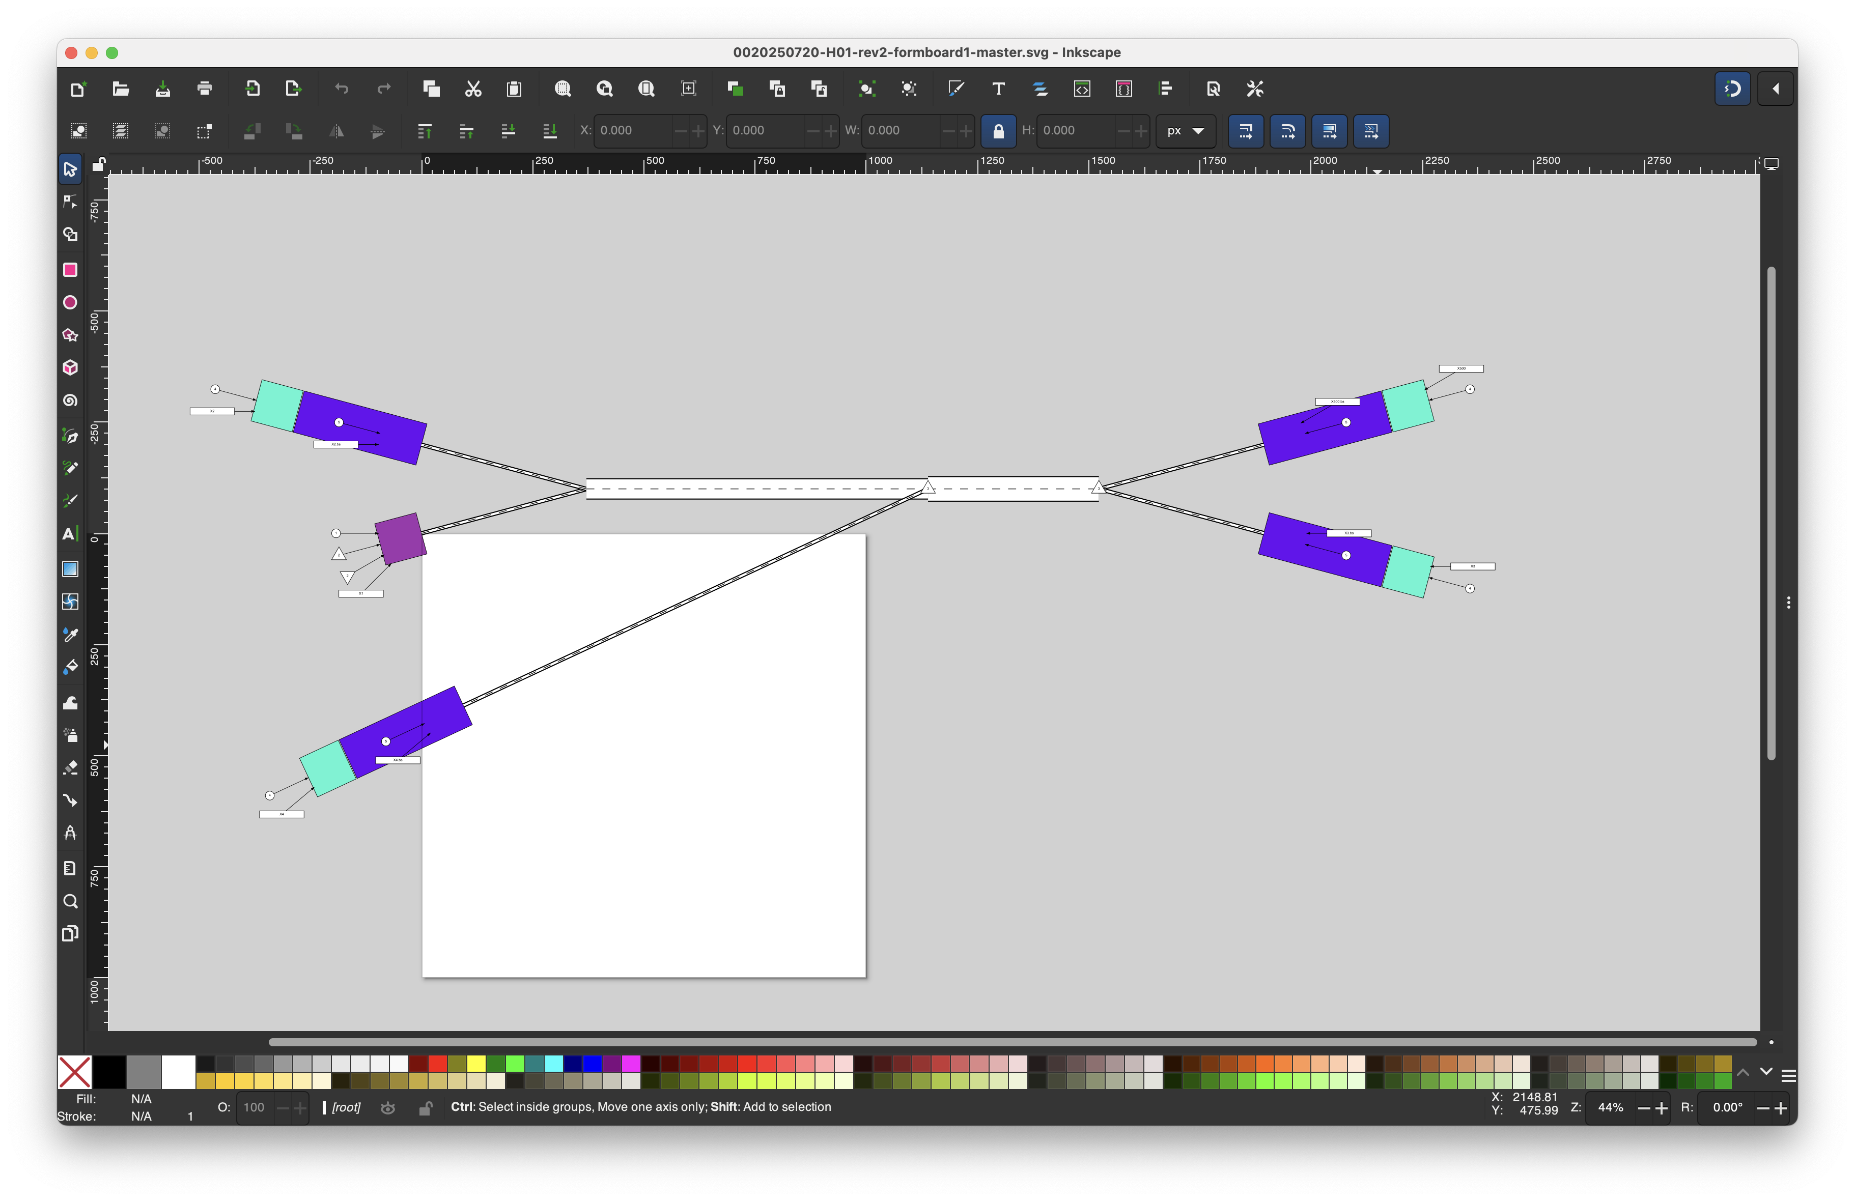
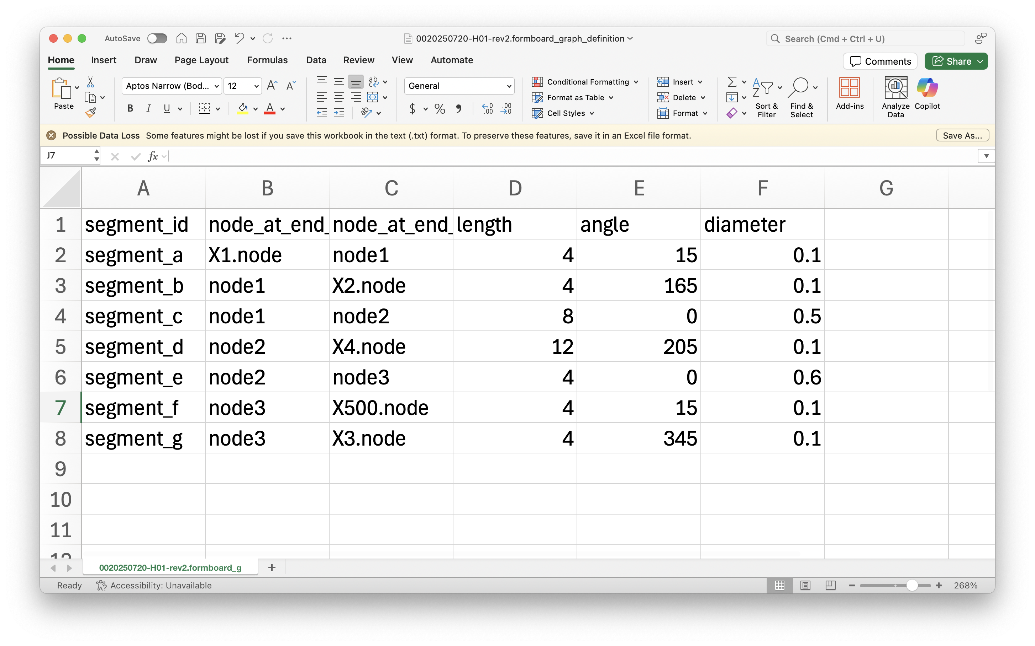

Slide 11
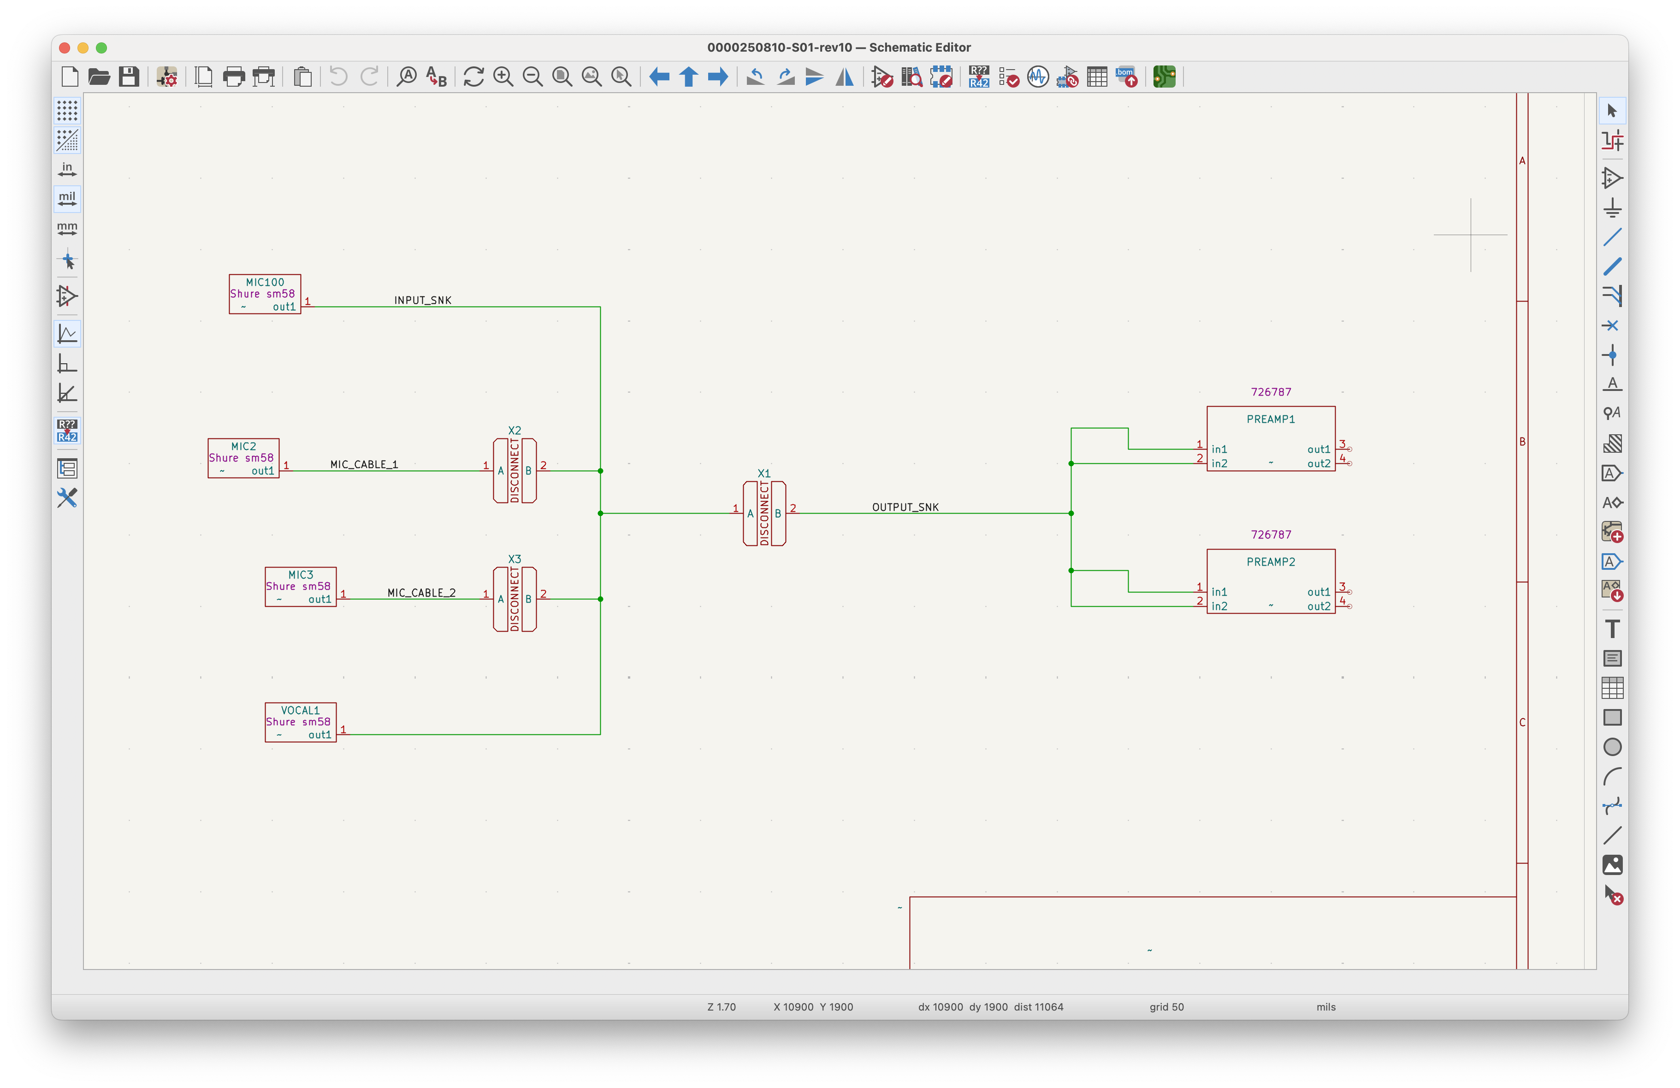
Disconnect symbol
Device symbol
Nets represent harnesses

Slide 12
How-to Harnice draft story START

Slide 13

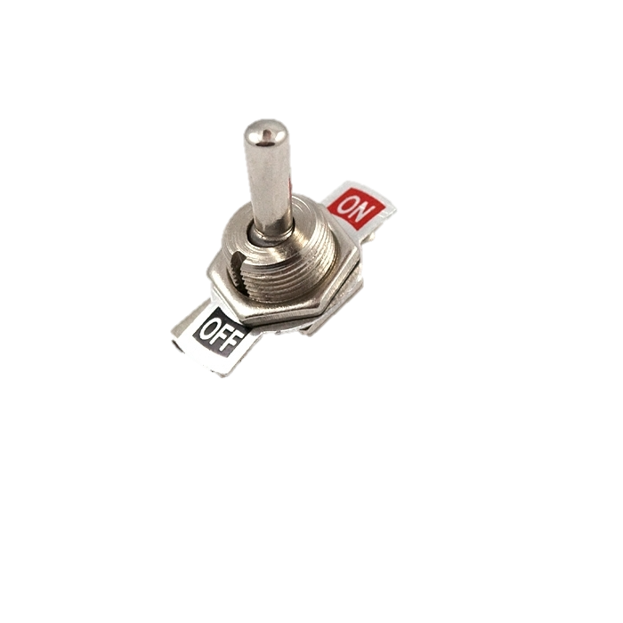
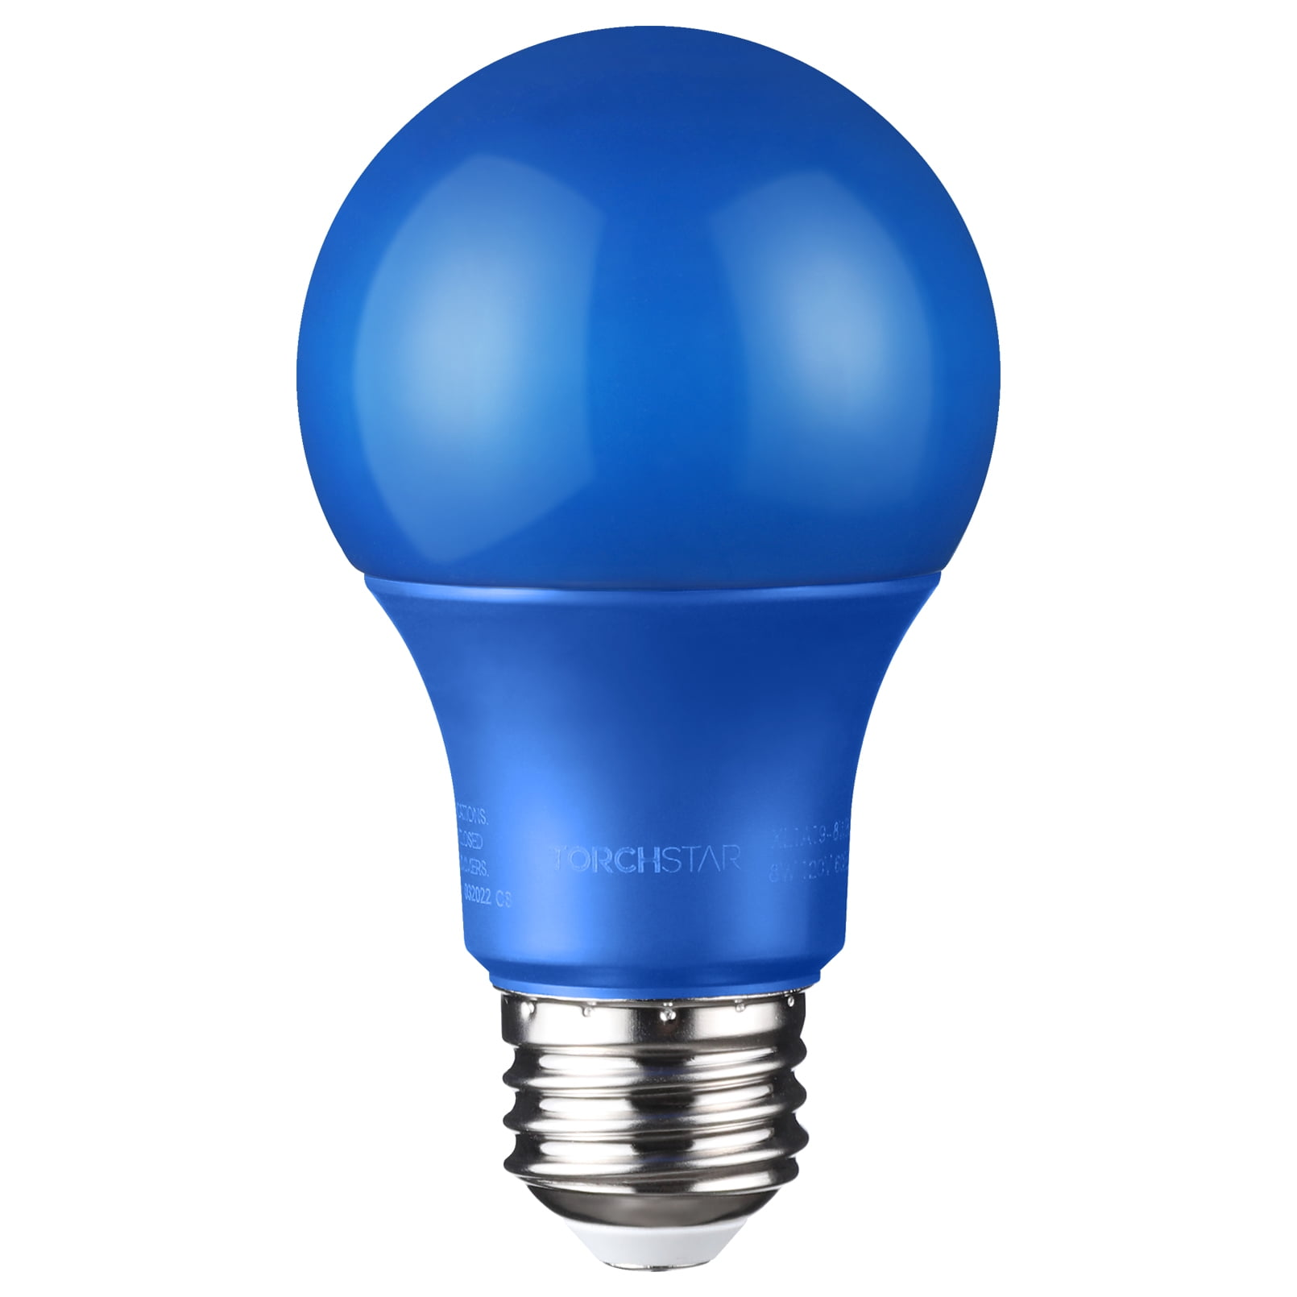
Any box that does electrical things in Harnice is called a device
Device 2
1
2
Connector 1
Device 1
A
B
E
C
D
Connector 1
Device 3
1
2
Connector 1

Slide 14
Devices have connectors which are mechanical interface points where harnesses can be fastened to the device
Device 2
1
2
connector
Connector 1
Device 1
A
B
C
connector
E
D
Connector 1
connector
Device 3
1
2
Connector 1

Slide 15
Devices also have channels which are sets of electrical signals that carry one complete piece of information or power into or out of the device.
Device 2
1
2
These connectors have one input channel each to power the bulb
Connector 1
Device 1
A
B
E
C
D
This connector has two output channels that apply power when their switch is on
Connector 1
Device 3
1
2
Connector 1

Slide 16
Let’s say you want to connect these devices together.
We need a harness that connects all three connectors together in this system.
A collection of devices and harnesses is called a system.
Device 2
1
2
Connector 1
Device 1
A
B
E
C
D
Connector 1
Device 3
1
2
Connector 1

Slide 17
This is how our system looks in a schematic view:
Device 1
Device 2
Connector 1
Connector 1
Channel 1
Channel 1
Channel 2
Device 3
Connector 1
This is a net. It represents the requirement for a harness.
Channel 2

Slide 18
Channels have channel types, some of which are compatible with each other.
Because these channels are part of the same net, they can be mapped to each other if they are compatible.
device1.channel1 (output)
device2.connector1 (input)
device1.channel2 (output)
device3.connector1 (input)

Slide 19
Let’s say we want to map these channels to each other:
device1.channel1 (output)
device2.connector1 (input)
device1.channel2 (output)
device3.connector1 (input)

Slide 20
Each channel has signals which represent the individual electrical information needed to transmit the channel type.
Signals are electrical interfaces into or out of a device
Because a channel is mapped, that means the signals of the devices need to be connected to each other. The requirement of this connection is called a circuit.
device1
channel1
device2
channel1
ch1.sig1
Circuit 3
ch1.sig1
ch1.sig2
Circuit 4
ch1.sig2
device1
channel2
Circuit 1
device3
channel1
ch2.sig1
ch2.sig1
Circuit 2
ch2.sig2
ch2.sig2
Circuits are requirements of connections of signals to other signals

Slide 21



Now that you have circuits established, you can start assigning parts to the harness.
Device 1
Device 2
Connector 1
Connector 1
A
Cable 2
1
Conductor 3
B
2
Conductor 4
Device 3
Conductor 1
Connector 1
C
Cable 1
1
Conductor 2
D
2
A cable is an off-the-shelf bundle of wires in a shield.
A conductor is a literal piece of wire
This cable contains conductors 1 and 2

Slide 22
Device 2
You can also assign mating connectors which have cavities (space where a contact, pin, socket) goes
Mating
Connector
Connector 1
Contact 1
Cavity 1
Device 1
Contact 2
Cavity 2
Connector 1
Mating
Connector
Cavity A
Contact 1
Cavity B
Contact 2
Cavity C
Contact 3
Cavity D
Contact 4
Cavity E
unused
Mating
Connector
Connector 2
Contact 1
Cavity 1
Contact 2
Cavity 2

Slide 23
How-to Harnice draft story END

Slide 24
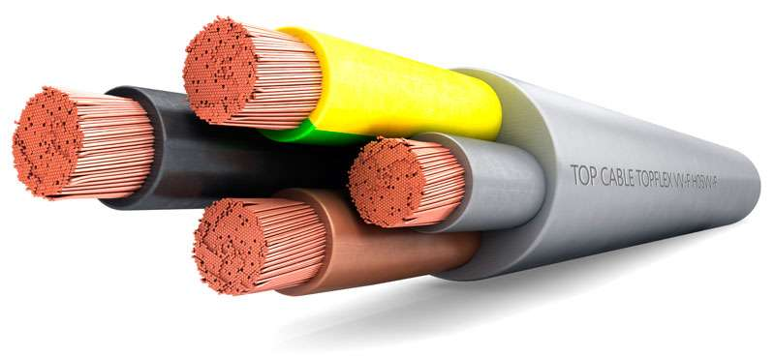
Mating connector (part of a harness that mechanically fastens to a connector in a device)
conductors
A channel is a set of signals that transmit or receive one piece of information
Net (requirement that a harness must exist here to connect these connectors)
Harness (physical part that satisfies a net)
Cable
A signal is a single electrical point conducting a voltage into or out of a device. Must be contained by a channel and by a connector
Mating connector cavity
Device 2
Device 1
Connector 1
Cavity 1
Channel 1
Contact
Cn1.Cavity 1
Connector 1
Ch1.sig1
Channel 1
Cn1.Cavity A
Cavity A
Ch1.sig1
Cavity 2
Cn1.Cavity 2
Ch1.sig2
Cn1.Cavity B
Cavity B
Ch1.sig2
Channel 2
Circuit (signals that must connect)
Cn1.Cavity C
Cavity C
Contact
A conductor is a physical wire that can be assigned to a circuit
Ch2.sig1
Cn1.Cavity D
Cavity D
Ch2.sig2
Cable: purchasable product that contains conductors, jacket, shield, etc
Cn1.Cavity E
Cavity E
Device 3
Two mapped channels
Connector 1
Cavity 1
Channel 1
A contact is a physical conductive part inside a connector that you can terminate conductors in
Cn1.Cavity 1
Ch1.sig1
Device connector
Cavity 2
Cn1.Cavity 2
Ch1.sig2
Device connector cavity
Cavity: hole where pins/sockets/contacts live inside a connector

